Slide 1
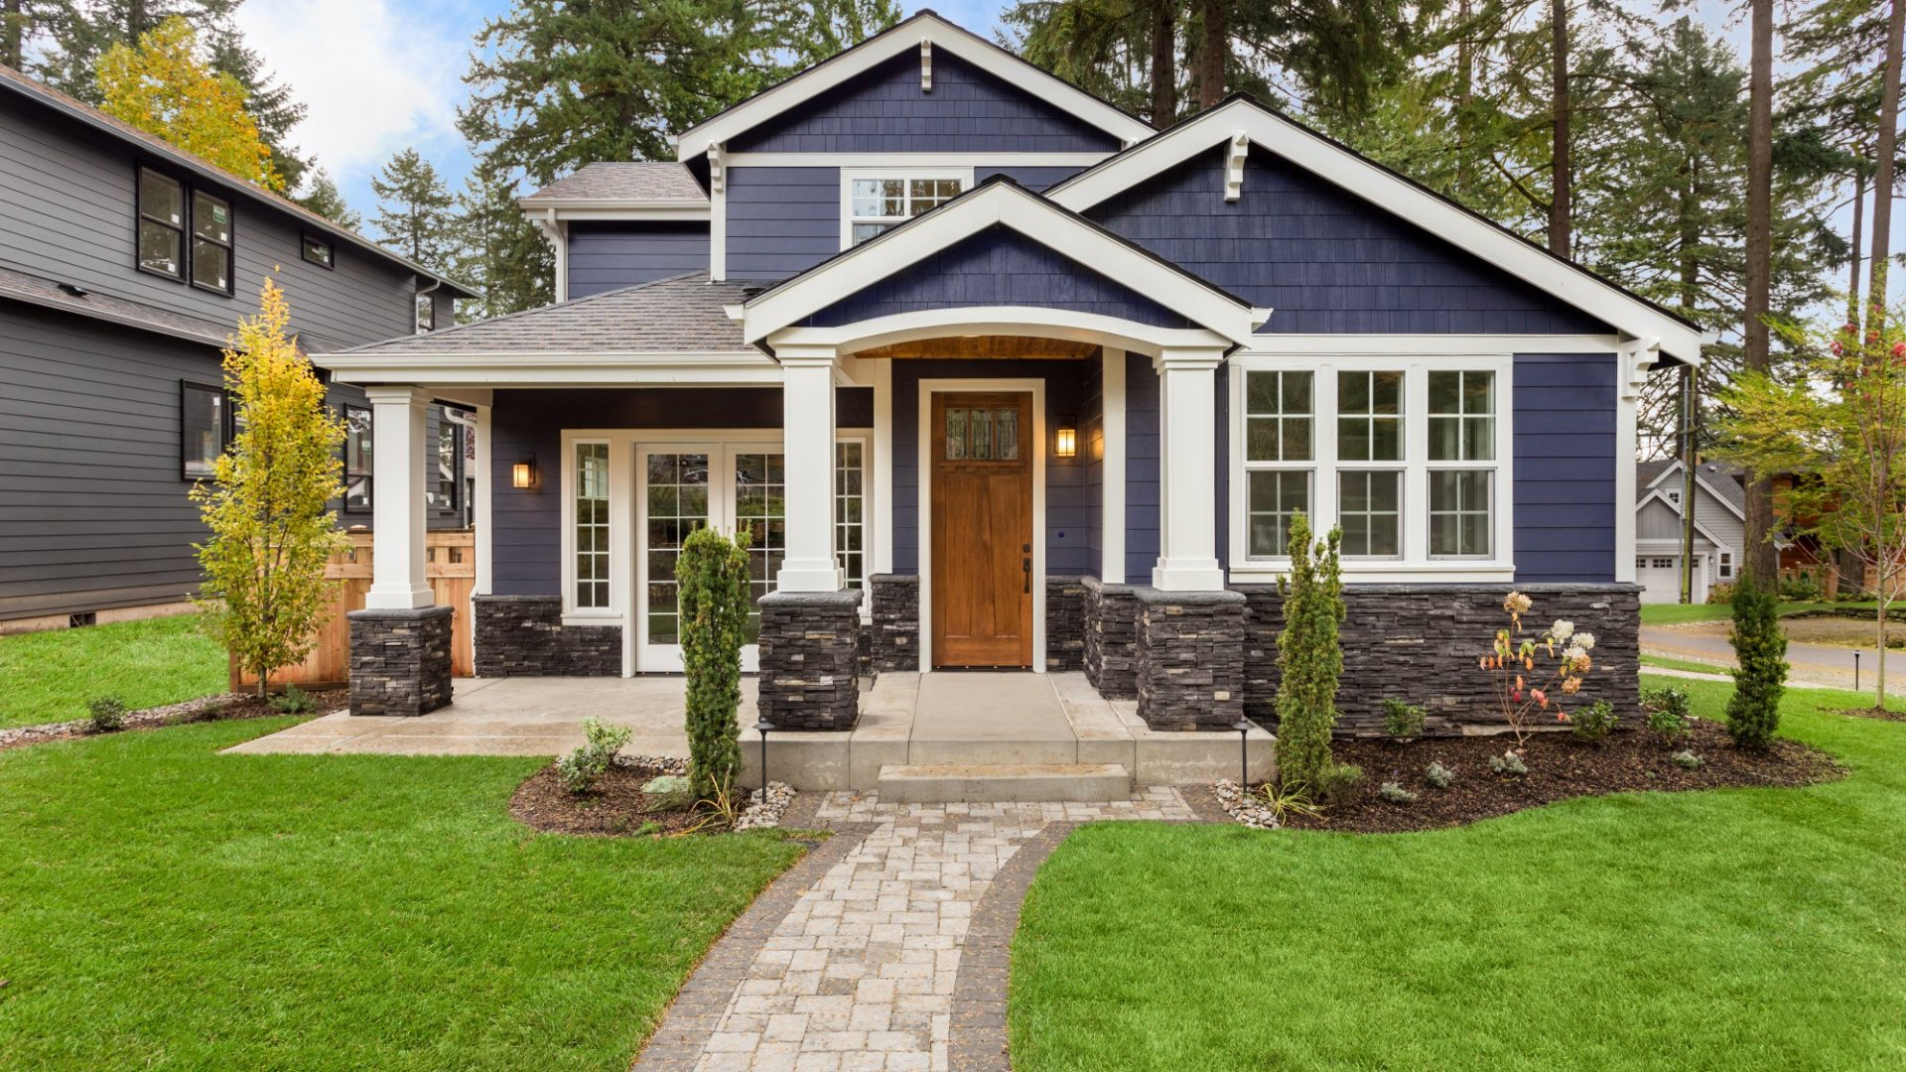
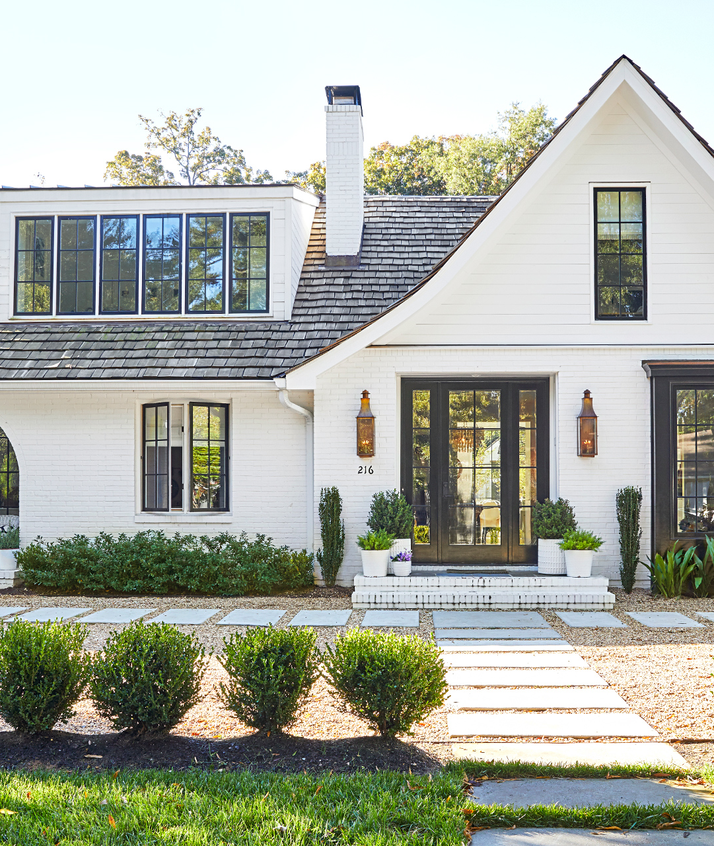
First Time Home Buying Made Easy
Ironhack Final Project
Feb. 2022

Slide 2
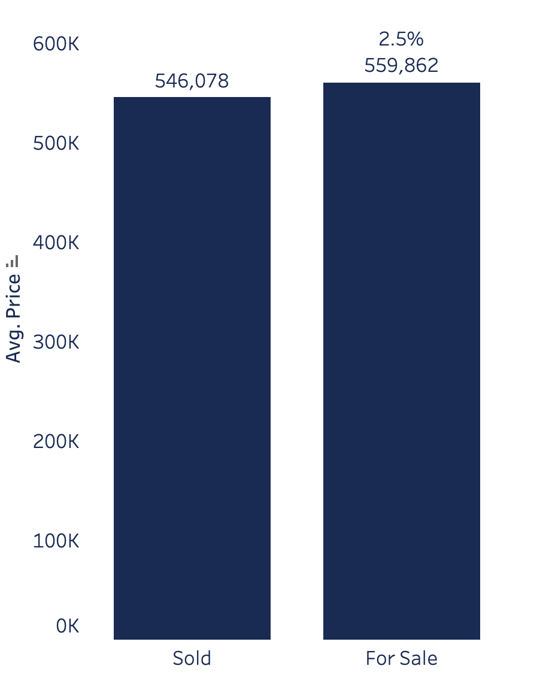
What makes a home valuable?
Home currently on the market
are priced 2.5% higher than their
recently sold counter parts
Market Inefficiency = Arbitrage Opportunity

Slide 3


Agenda
Review tableau analysis
Discuss data collection methods
Modeling
Data cleaning
Multicollinearity
Transformations
Scaling
Feature Selection
Model Types
Model Results
Preliminary Findings
Future Modifications and Improvements

Slide 4
Key Drivers of Home Value
Size
Neighborhood
Age/Timing
Amenities
Structural Integrity
Exterior Quality
Marketing Success

Slide 5
What makes a home valuable?
Size
Bedrooms
Bathrooms
Square Feet
Basement Square feet
Garage Square Feet
Land Square Feet
Acres

Slide 6
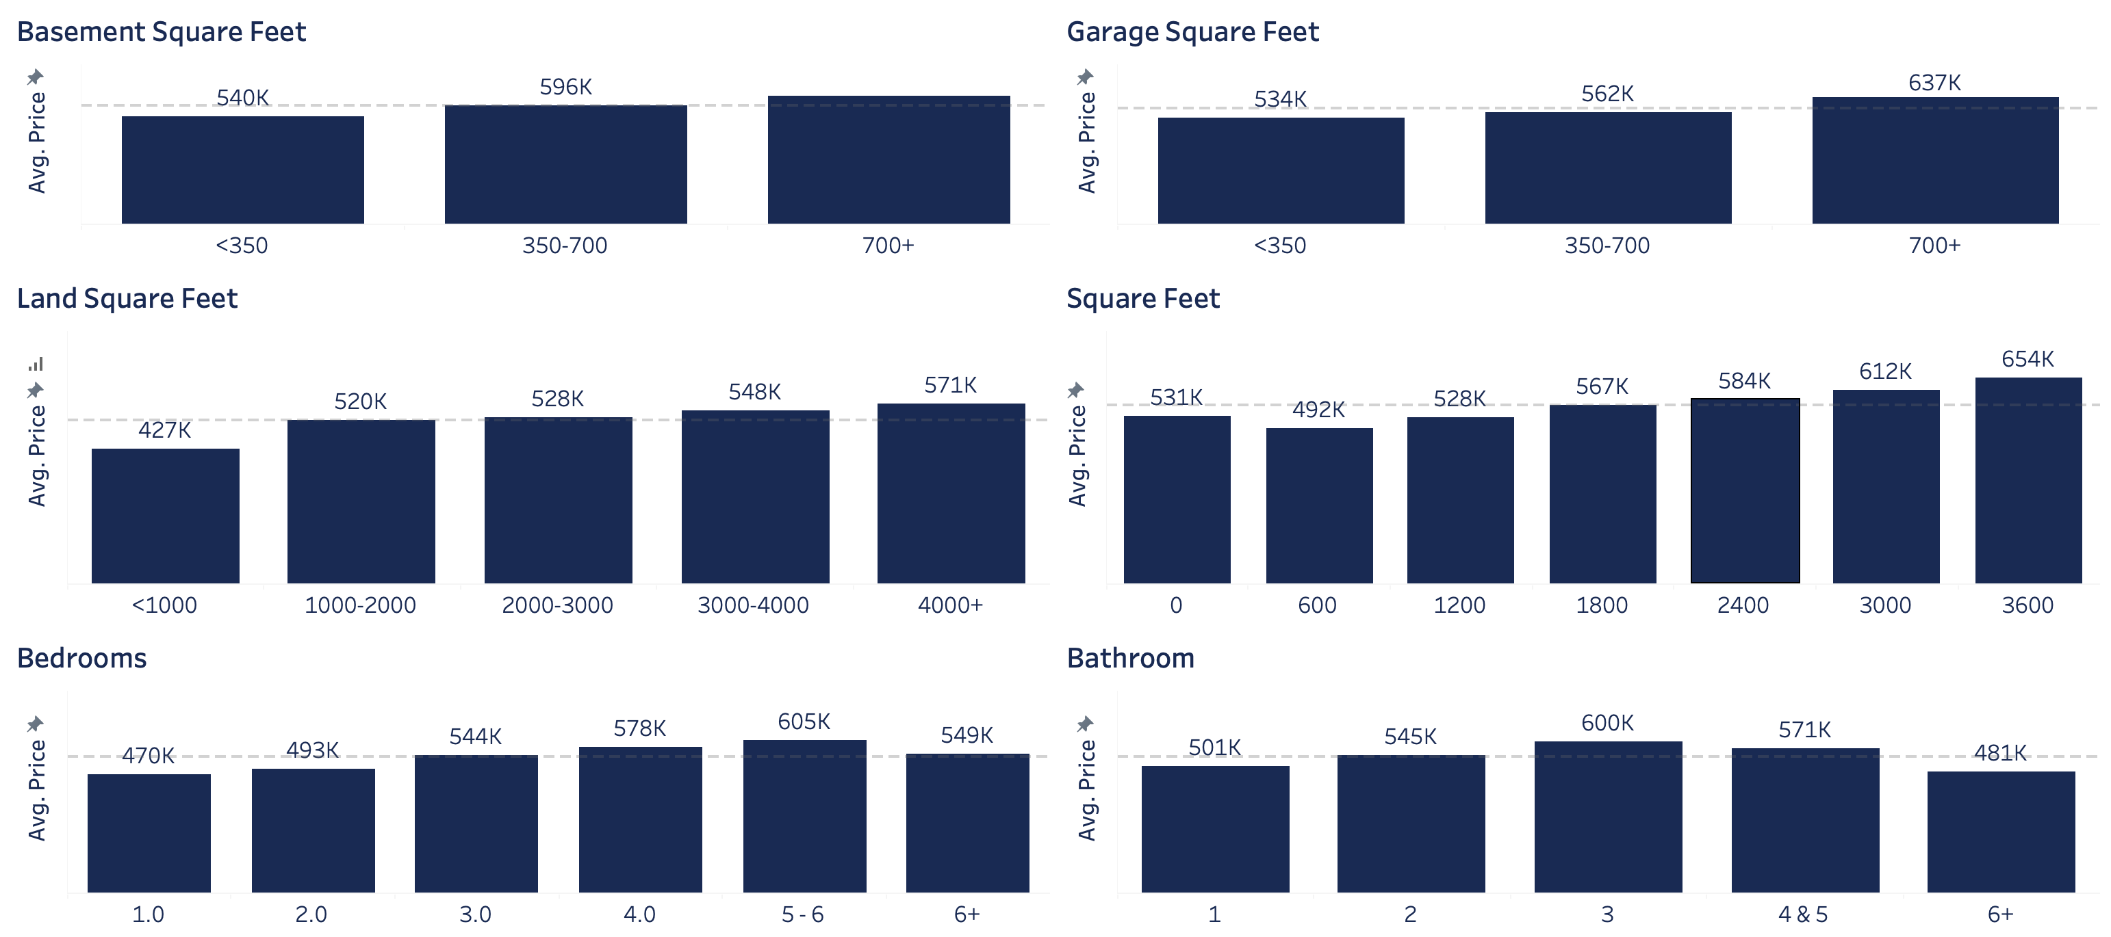
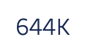
What makes a home valuable?
Size
- Continuous - Positive Relationship - Kept
- Continuous - Positive Relationship - Kept
- Continuous - Positive Relationship - Kept
- Continuous - Positive Relationship - Kept
- Categorical - Positive Relationship - Dropped
- Categorical - Unclear Relationship - Dropped

Slide 7
What makes a home valuable?
Neighborhood
Location
Public School Rating
Private School Rating
Public School Student Count
Private School Student Count
Student to Teacher Ratio
Tax Rates

Slide 8
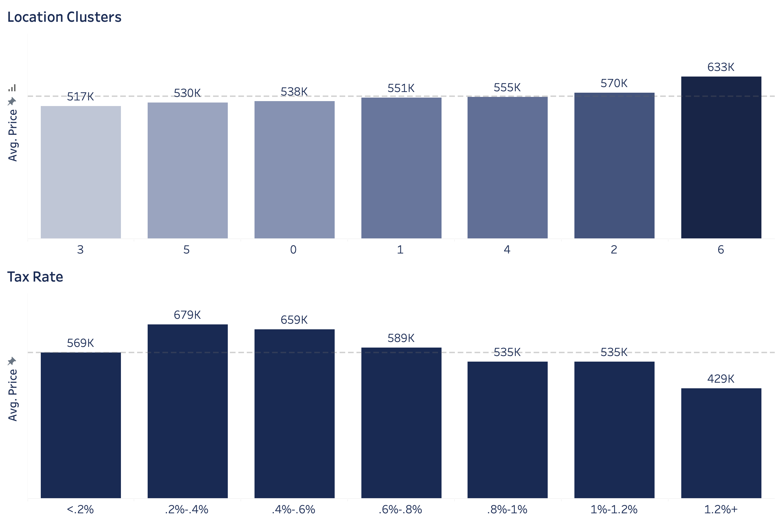
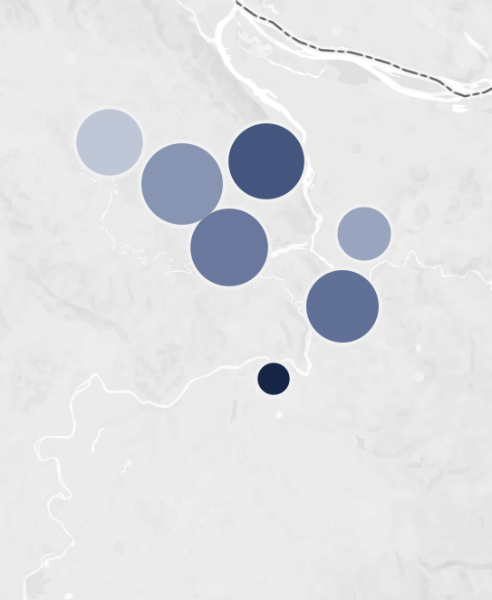
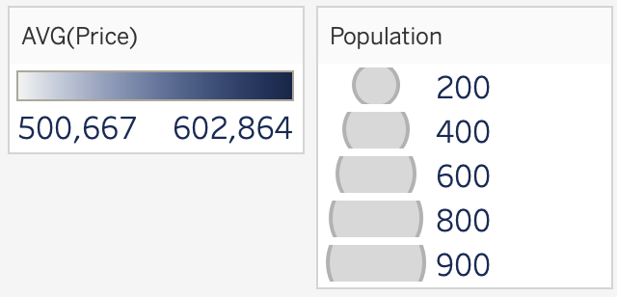
What makes a home valuable?
Neighborhood
- Categorical - Unclear Relationship - Dropped
- Continuous - Negative Relationship - Kept

Slide 9
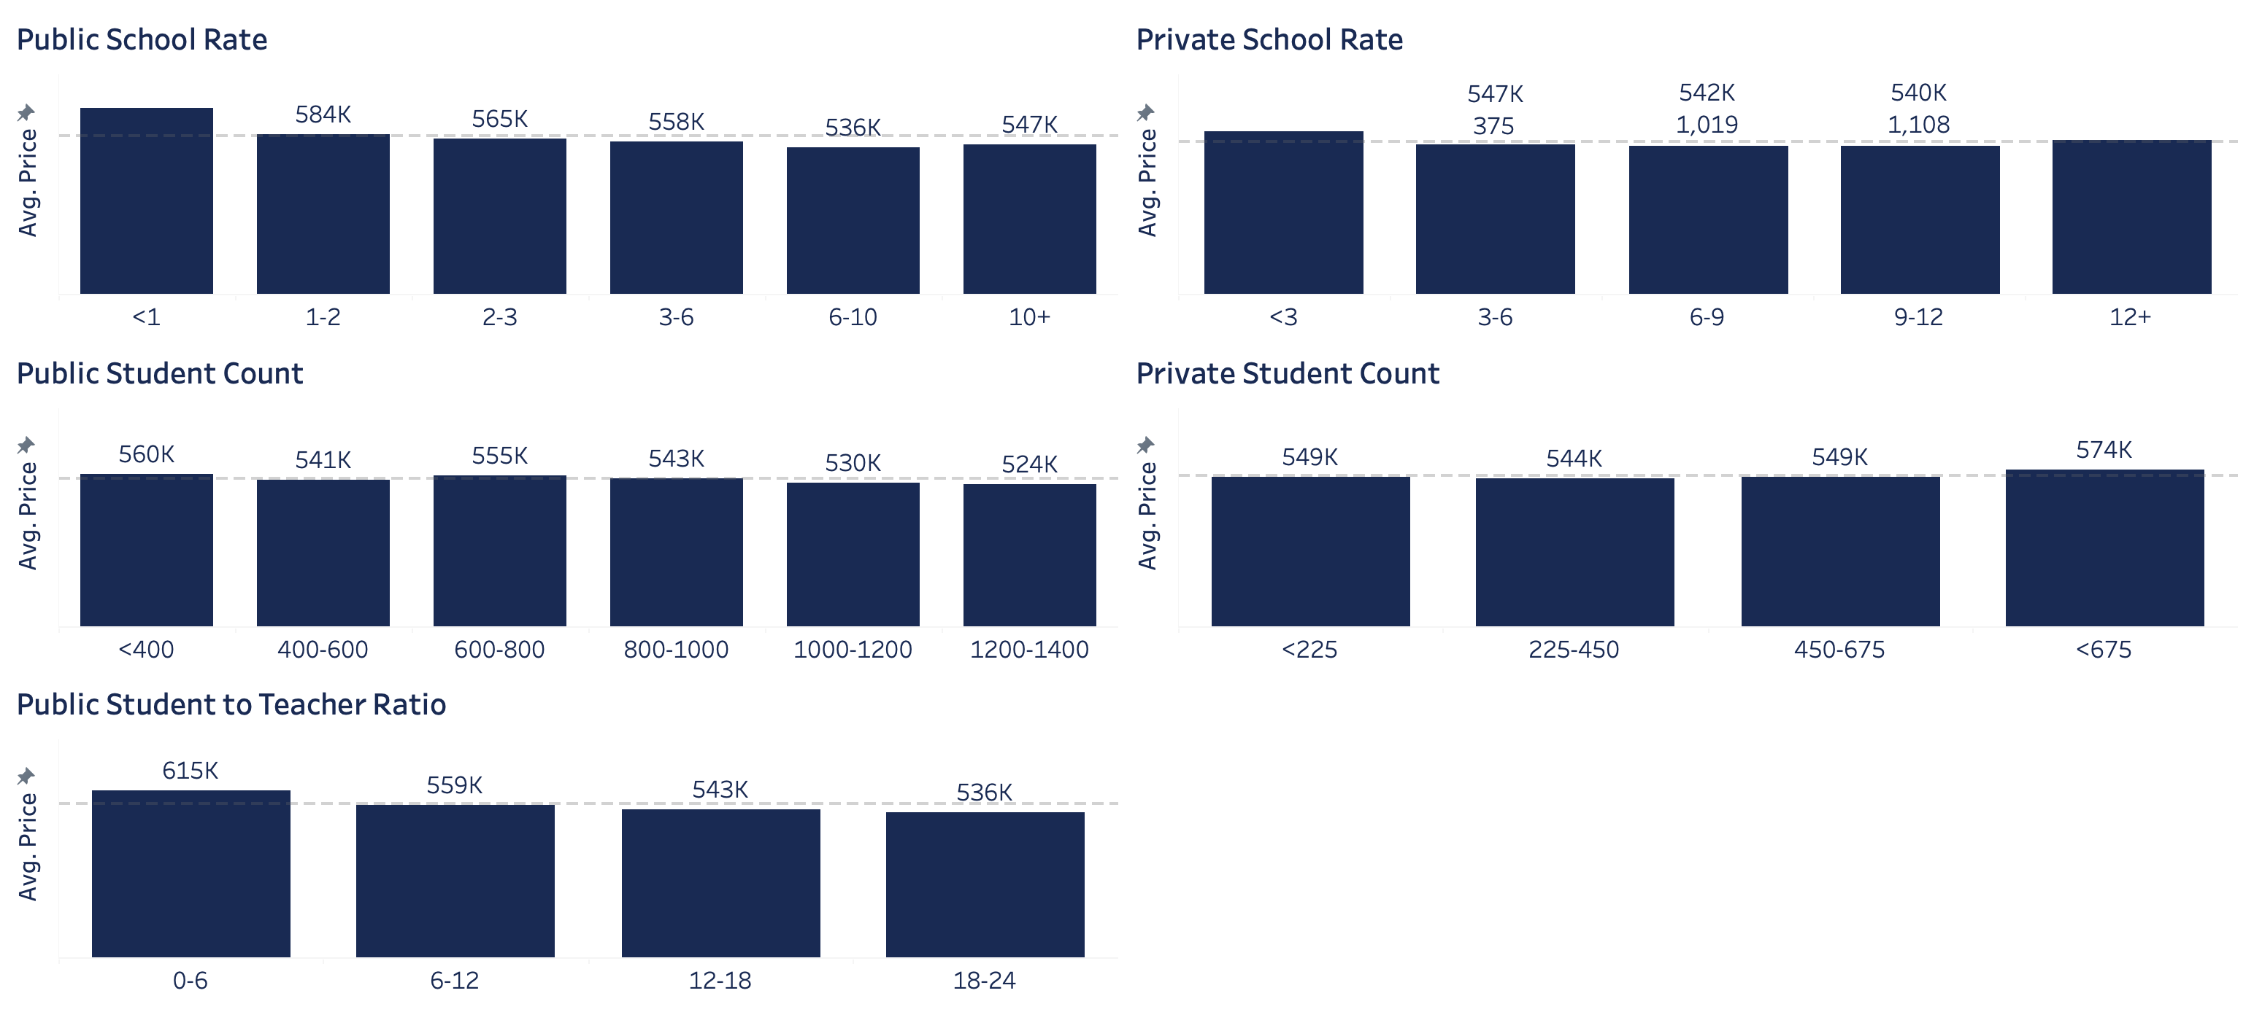
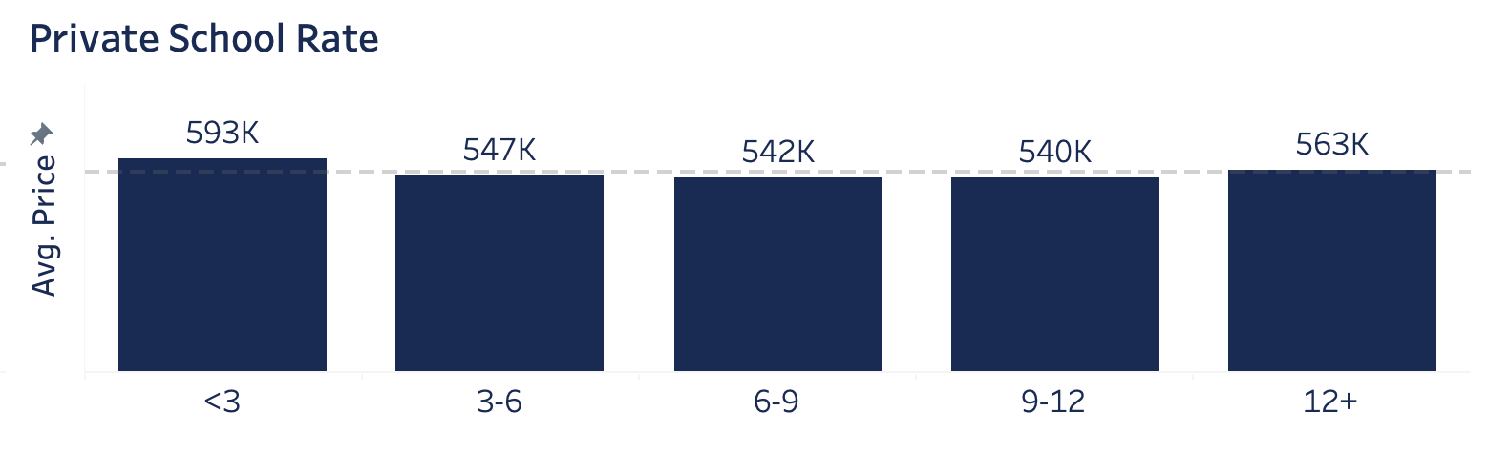
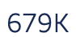
What makes a home valuable?
Neighborhood
School Systems
- Continuous - Negative Relationship - Kept
- Continuous - Negative Relationship - Kept
- Continuous - Positive Relationship - Kept
- Continuous - Negative Relationship - Kept
- Continuous - Negative Relationship - Kept

Slide 10
What makes a home valuable?
Age/Timing
Year Bought
Year Built
Year Renovated
Year Assessed

Slide 11
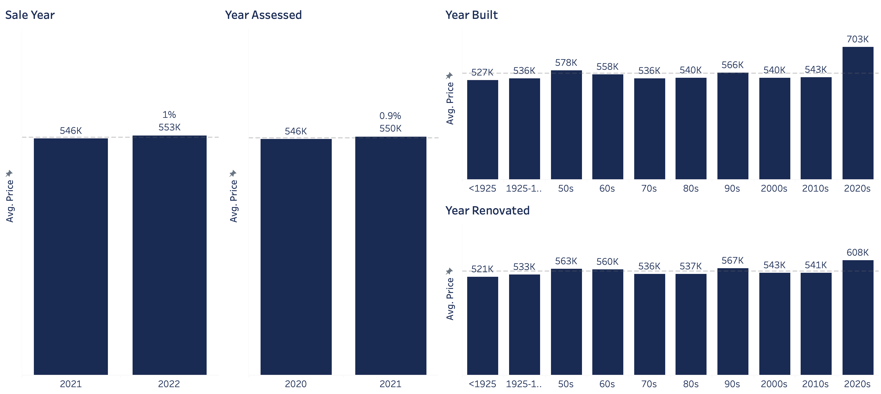
What makes a home valuable?
Age/Timing
- Categorical - Positive Relationship - Dropped
Categorical - Positive Relationship - Dropped
Categorical - Positive Relationship - Dropped
- Categorical - Positive Relationship - Dropped

Slide 12
What makes a home valuable?
Amenities
Total Number of “Amenities”
Bathroom Fixtures
Fireplace Type
Number of Fireplaces
Type of Garage
Pool

Slide 13
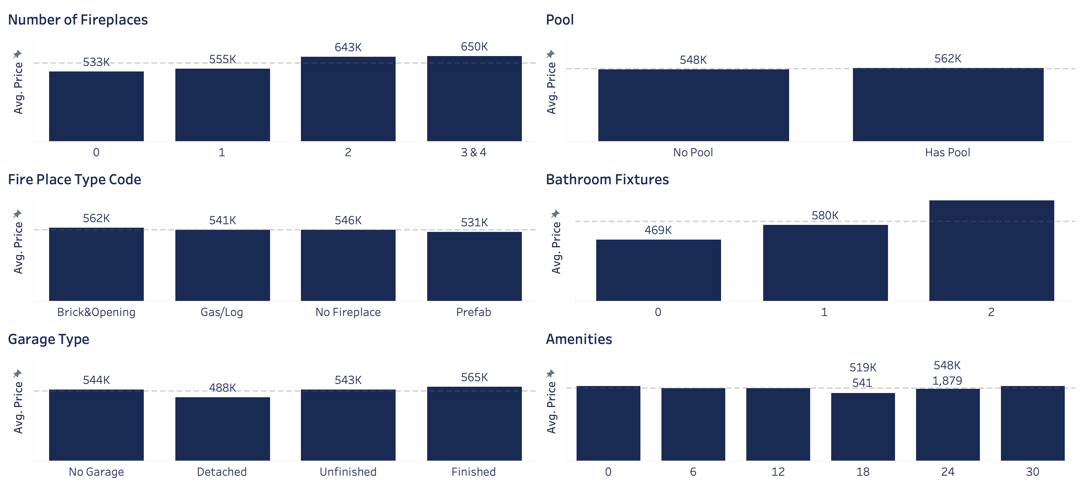

What makes a home valuable?
Amenities
- Categorical - Positive Relationship - Dropped
- Categorical - Positive Relationship - Dropped
- Categorical - Dropped
- categorical – Positive Relationship - Dropped
- Categorical – Kept Some
- Continuous – Unclear Relationship - Dropped

Slide 14
What makes a home valuable?
Structural Integrity
Foundation Type
Roof Type
Exterior Wall Type
Heating Type

Slide 15
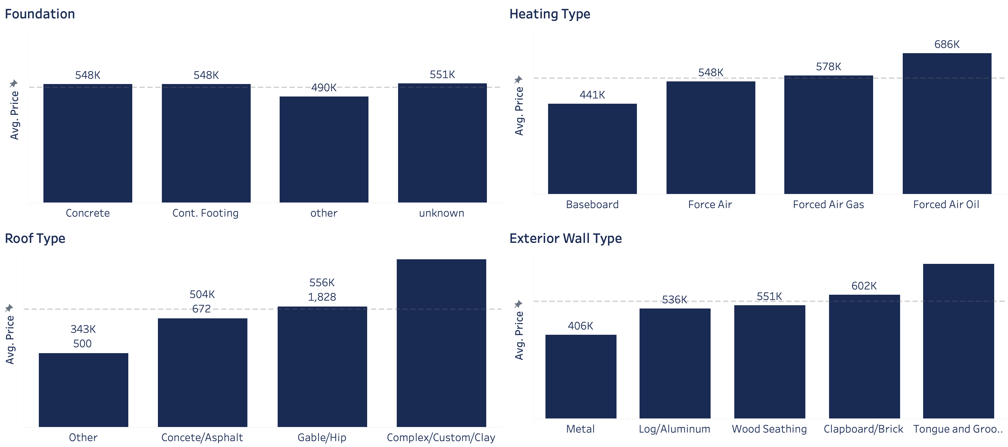
What makes a home valuable?
Structural Integrity
- Categorical – Kept Some
- Categorical – Dropped
- Categorical – Kept
- Categorical – Kept

Slide 16
What makes a home valuable?
Exterior Quality
Building Quality Level
Property Type

Slide 17
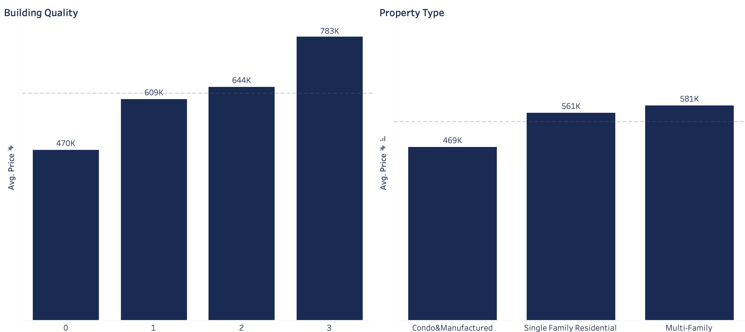
What makes a home valuable?
Exterior Quality
- Categorical – Kept Some
- Categorical – Kept Some

Slide 18
What makes a home valuable?
Marketing Success
Days on the Market
Tour Counts
Webpage Favorites
Webpage Views

Slide 19
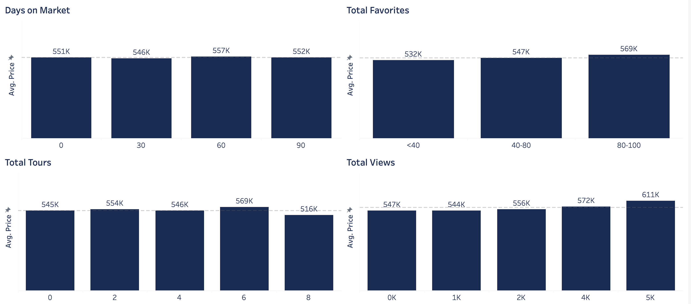
What makes a home valuable?
Marketing Success
- Categorical - Positive Relationship - Kept
- Categorical - Positive Relationship - Kept
- Categorical - Positive Relationship - Kept
- Categorical - Positive Relationship - Dropped

Slide 20
Agenda
Review tableau analysis
Discuss data collection methods
Modeling
Tools
Data cleaning
Transformations
Multicollinearity
Scaling
Feature Selection
Model Methods
Model Results
Preliminary Findings
Future Modifications and Improvements

Slide 21
Data Collection
Source: Redfin
Methods:
Web Scrapping
API Connection

Slide 22
Modeling
Tools
Models
sklearn.ensemble import RandomForestRegressor
sklearn.datasets import make_regression
sklearn.cluster import DBSCAN
sklearn.linear_model import LinearRegression
sklearn import linear_model
sklearn.preprocessing import OneHotEncoder
sklearn.model_selection import train_test_split
tensorflow as tf
statsmodels.api
Multicollinearity/Scaling
scipy.stats import chi2_contingency
atsmodels.stats.outliers_influence import variance_inflation_factor
sklearn.preprocessing import MinMaxScaler
sklearn.preprocessing import Normalizer
sklearn.preprocessing import StandardScaler
sklearn.model_selection import GridSearchCV
from sklearn.model_selection import RandomizedSearchCV
klearn.feature_selection import RFE
sklearn.decomposition import PCA
Gen. Math/Accuracy Measures
statistics as stats
ststatistics
scipy import stats
sklearn import metrics
sklearn.metrics import mean_squared_error, r2_score, mean_absolute_error
math
Visualizations
matplotlib.pyplot
seaborn
matplotlib import pyplot

Slide 23
Modeling
Data Cleaning
See Python

Slide 24
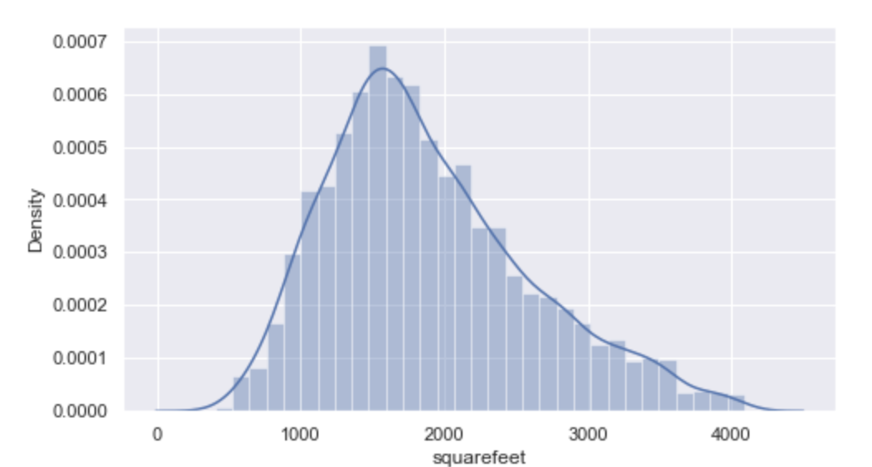
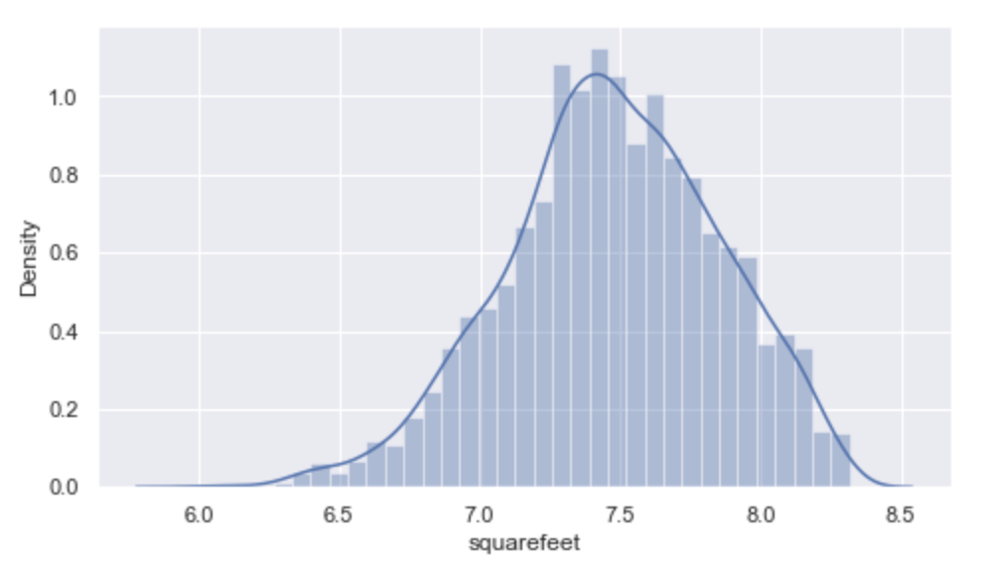
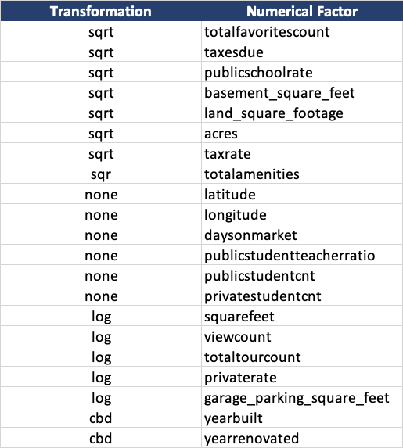
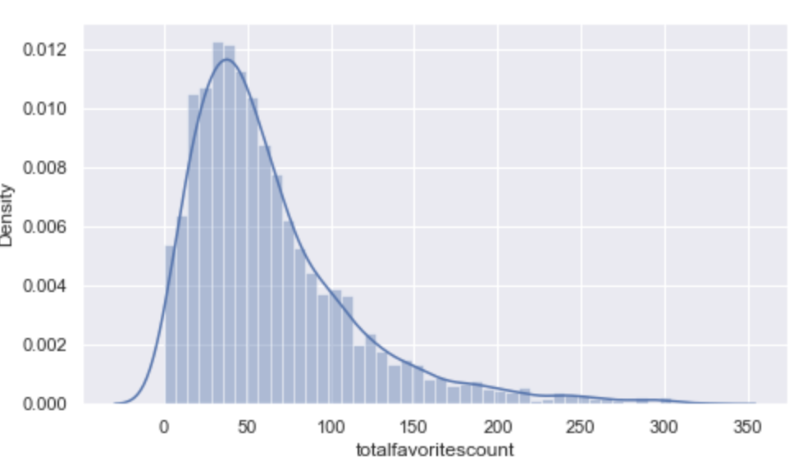
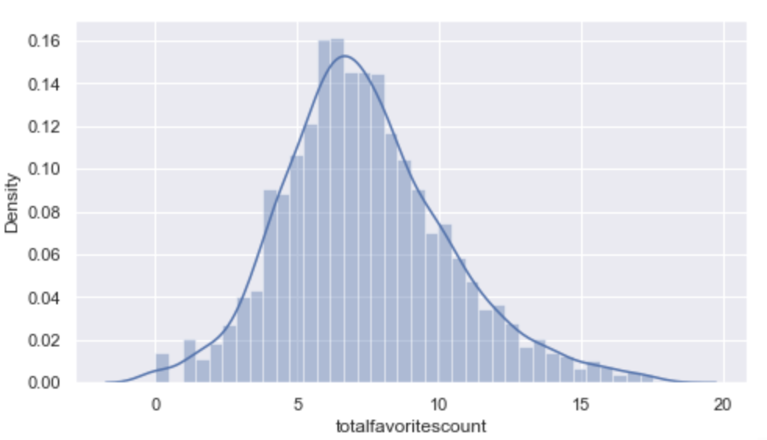
Modeling
Transformations
Land Square Feet: Before
Land Square Feet: log
Favorites: Before
Favorites: sqrt

Slide 25
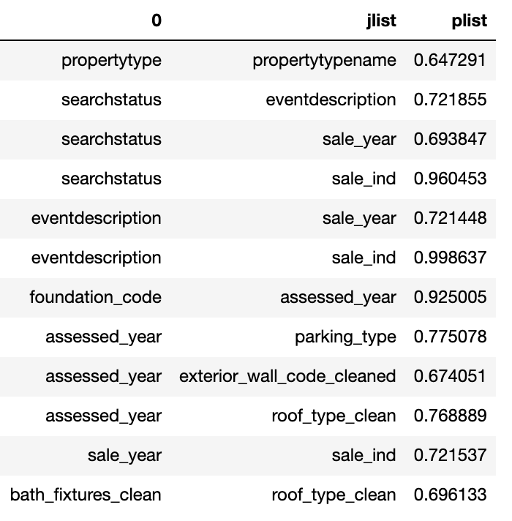
Modeling
Multicollinearity
Continuous:
Threshold: VIF=500 and correlation <.7
Dropped:
Taxes Due
View count
Year Built
Year Renovated
Categorical:
Threshold: Chi squared p-value <.6
Dropped:
Assessed Year
Event description
Bathroom Fixtures
Property Type
Sale Year
Feature Correlated Feature Correlation

Slide 26
Modeling
Scaling
Min – Max Scaler
Best for:
Random Forest (although barely effected by scaling)
Neural Networks
Standardizer
Best for:
Linear Regression
Normalizer
Will cover more thoroughly in accuracy section

Slide 27
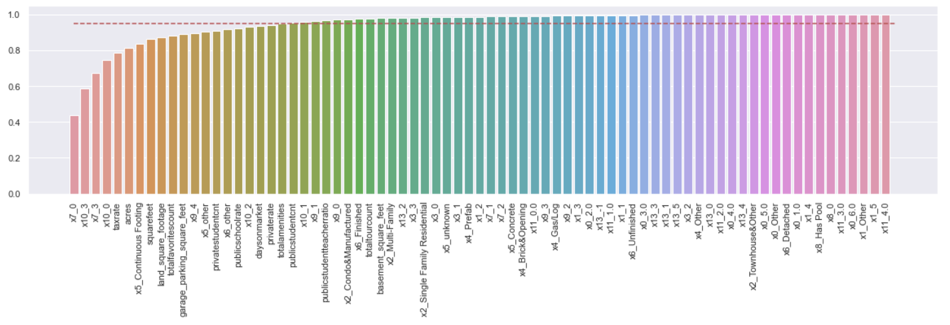
Modeling
Feature Selection
Best results from random forest feature importance
Found 95% of target is explained by top 30% of the features
Also tried RFE feature selection

Slide 28
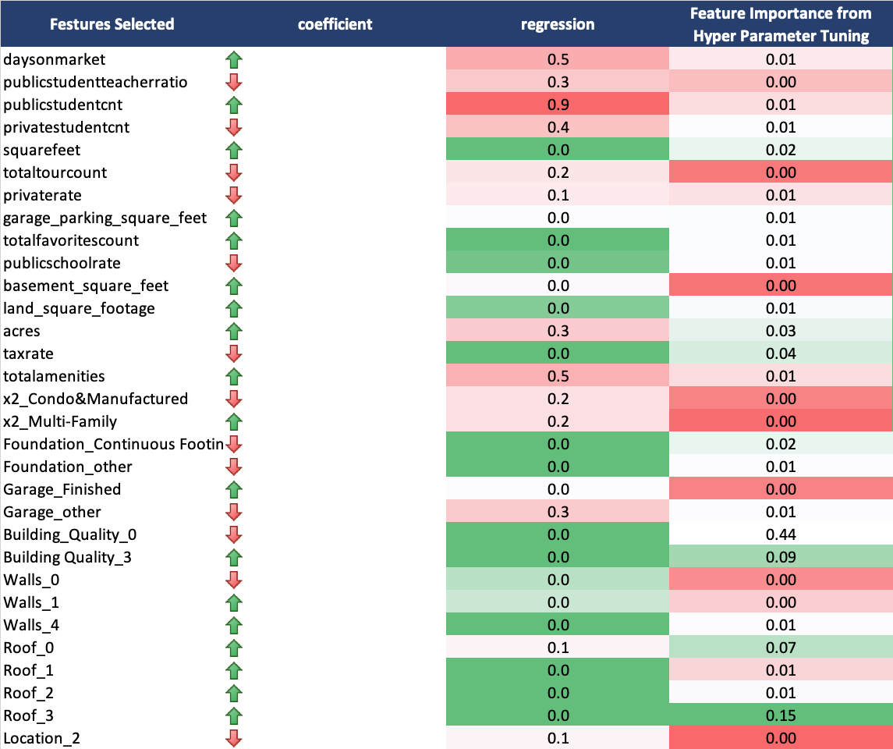
Modeling
Feature Selection
Relative feature importance provided by linear regression anova table doesn’t align with the random forest features

Slide 29
Modeling
Model Methods
Random Forest
Multiple Linear Regression
Neural Networks

Slide 30
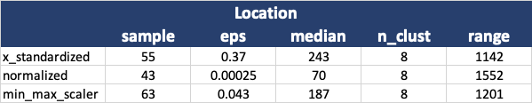
Modeling
Model Methods
Clustering for location
DBScan
Wanted to a method that produced the least diviation between cluster sizes and at least 7 clusters
Standardizer gave the best results:

Slide 31
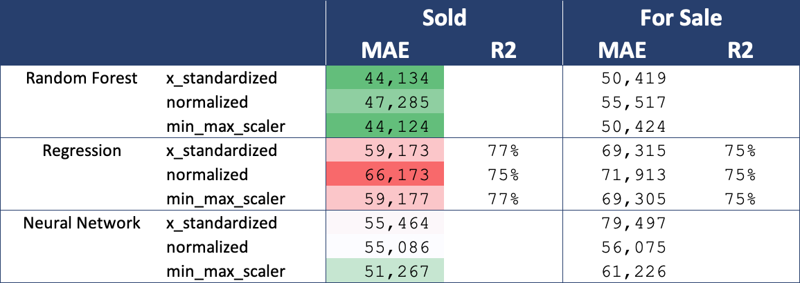
Modeling
Model Results
Primary accuracy measure used is mean squared error:
Random Forest had the best results!!

Slide 32
Agenda
Review tableau analysis
Discuss data collection methods
Modeling
Data cleaning
Multicollinearity
Transformations
Scaling
Feature Selection
Model Types
Model Results
Preliminary Findings
Future Modifications and Improvements

Slide 33
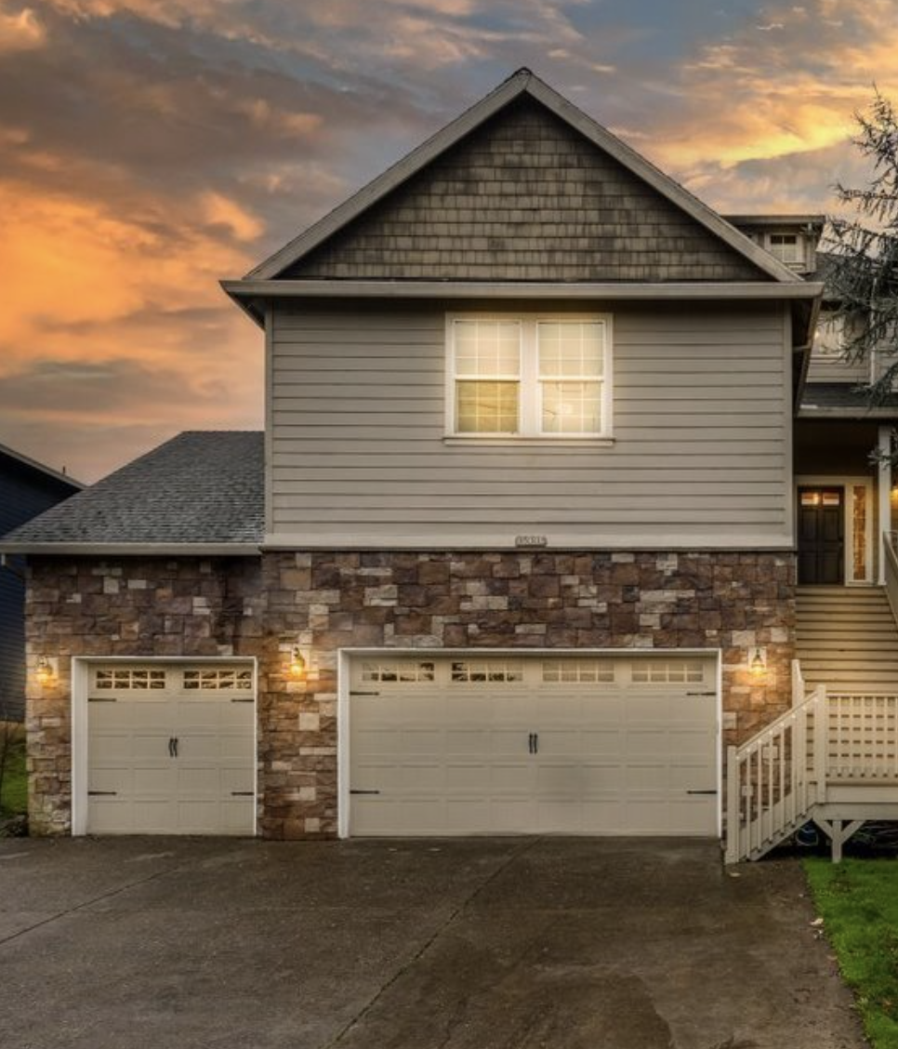
Preliminary Findings
15996 Apperson Blvd, Oregon City, OR
Since starting this project 8 homes that the random forest said were underpriced have been sold…
Of them almost all of them sold for more more than the listing price but many still sold for less than the model valued them at…

